Slide 1
End-to-End Response Latency Prediction in Microservice Applications
Haytham Mohamed
DSU – INFS890 – Spring 2020

Slide 2
Brief Introduction
Empirical investigation to use machine learning approach to predict end to end response latency prediction in a microservice application in cloud deployed on Kubernetes

Slide 3
Problem
Predicting response latency in containerized microservice application in cloud.
End-to-End latency of a scenario in a containerized application
Example:
Predicting an end-to-end response time of a user checkout use-case flowing through a shopping application deployed as a containerized microservice in cloud

Slide 4
Usefulness
Reliability prediction
Scaling decision making
Anomaly detection
Alerting
Observation
Contributing to AIOPs

Slide 5
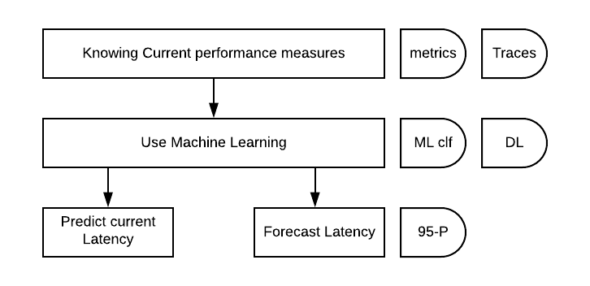
Trends

Slide 6
Related Work
Current response latency prediction using performance metrics
﻿Rahman, J., & Lama, P. (2019). Predicting the end-to-end tail latency of containerized microservices in the cloud. Proceedings - 2019 IEEE International Conference on Cloud Engineering, IC2E 2019, 200–210. https://doi.org/10.1109/IC2E.2019.00034
Bao, L., Wu, C., Bu, X., Ren, N., & Shen, M. (2019). Performance modeling and workflow scheduling of microservice-based applications in clouds. IEEE Transactions on Parallel and Distributed Systems, 30(9), 2101–2116. https://doi.org/10.1109/TPDS.2019.2901467

Slide 7
Related Work
Future response latency Prediction
Barnes, B. J., Reeves, J., Rountree, B., De Supinski, B., Lowenthal, D. K., & Schulz, M. (2008). A regression-based approach to scalability prediction. Proceedings of the International Conference on Supercomputing, 368–377. https://doi.org/10.1145/1375527.1375580
Sadjadi, S. M., Shimizu, S., Figueroa, J., Rangaswami, R., Delgado, J., Duran, H., & Collazo-Mojica, X. J. (2008). A modeling approach for estimating execution time of long-running scientific applications. IPDPS Miami 2008 - Proceedings of the 22nd IEEE International Parallel and Distributed Processing Symposium, Program and CD-ROM, (November 2015). https://doi.org/10.1109/IPDPS.2008.4536214

Slide 8
Gap
To the best of my knowledge no recent research (investigation) on using different performance metrics on both application and platform levels (other than just CPU measures) to predict end-2-end latency of a containerized application deployed in cloud.
To the best of my knowledge no recent research (investigation) on using historical metrics to forecast future end-2-end latency using different measures of a containerized application deployed in cloud.

Slide 9
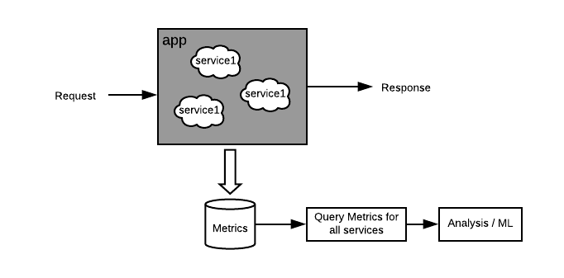
Method
Deploy a containerized microservice shopping application on K8 in cloud. Apply load to the app’s “checkout” flow and collect different performance metrics of all service participate in the flow.
Analyze to predict e-2-e latency using the collected metrics
Compare between different ML models [LR, CVR, RandomTreeRegressor, MLP, ..]

Slide 10
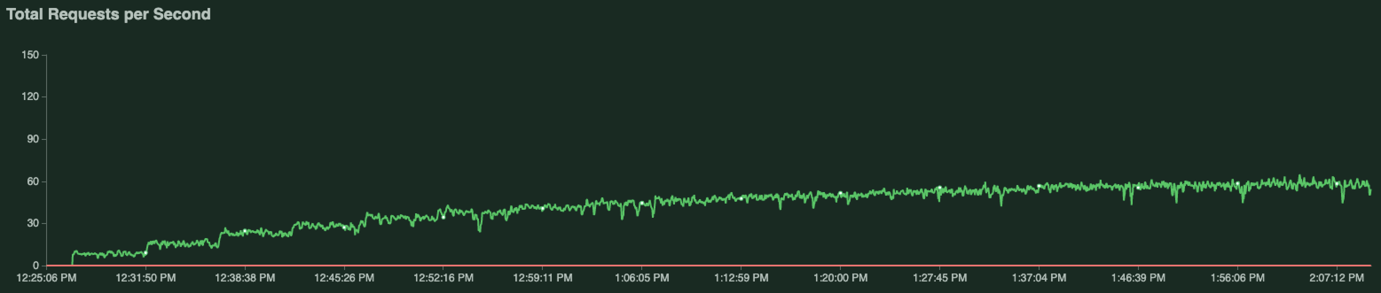
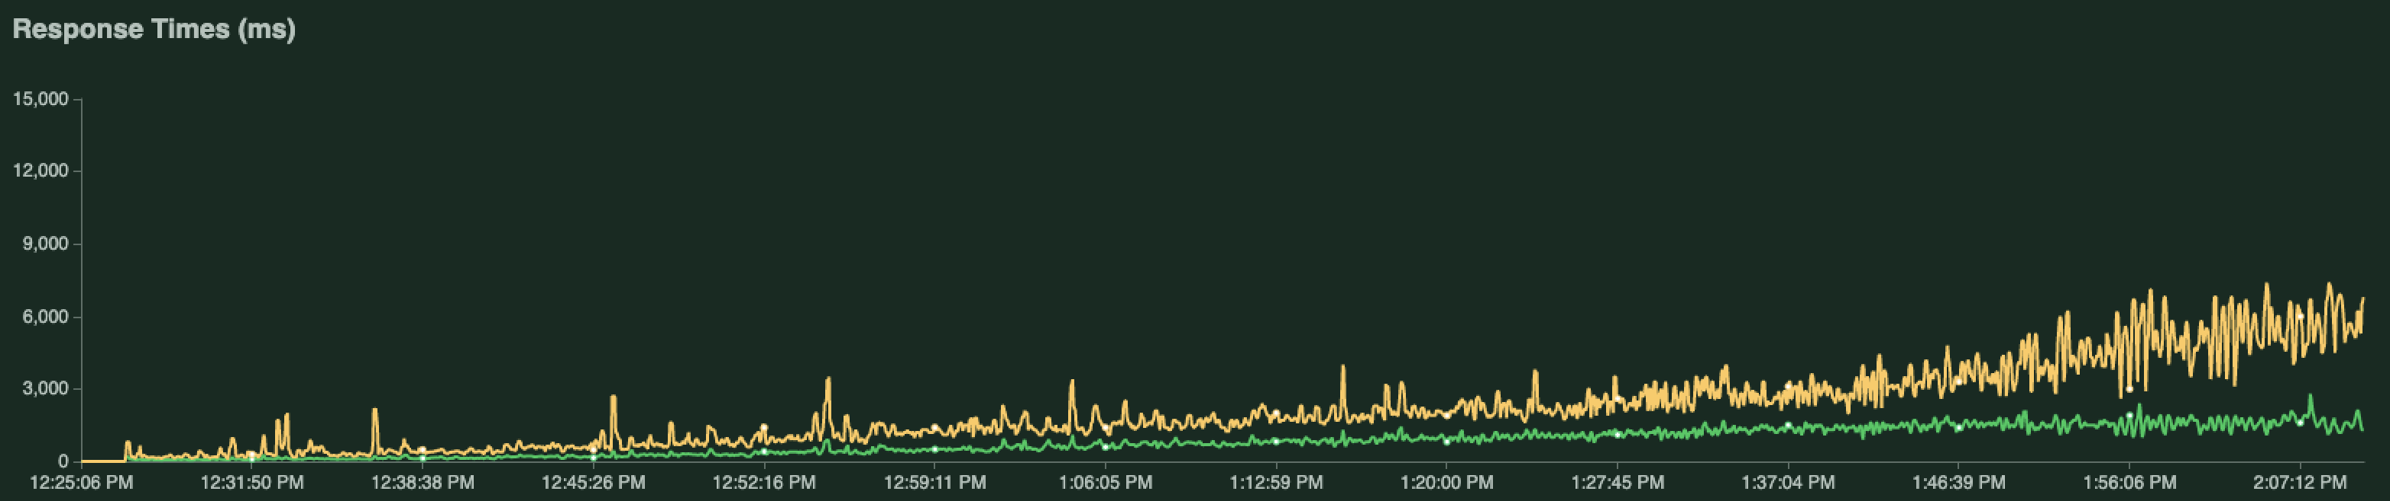
Experiment
Deployed Hipster open source app https://github.com/GoogleCloudPlatform/microservices-demo to k8s in cloud and applied different loads to the “checkout” end point

Slide 11
Performance Metrics
Services CPU Use
Services CPU Saturation
Services Network Use
Services Disk Use
Service request rate
Service Request size
Service Response size
System CPU use
System CPU saturation
System network Use
Number of containers
95-percentile Latency
Application is deployed on k8s and Istio is used
Istio helps to observe metrics on service levels
Rules are created to pre-calculate metrics
Metrics scraped every 15 seconds
Metrics rated over 1-minute time-window
Collected 1584 samples of computed measurements
Shape of data 1584 x 12
11 features
1 target (continuous value)

Slide 12
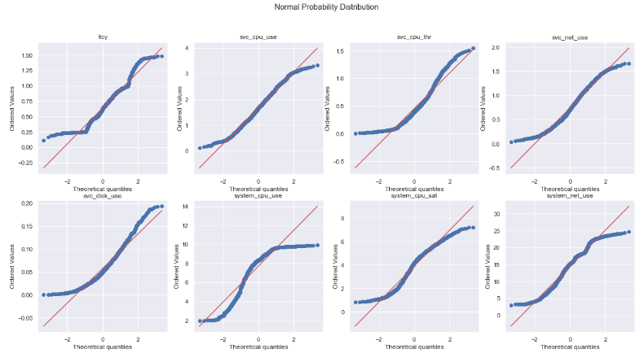
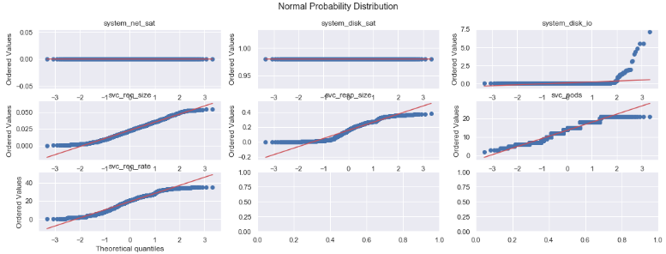
Preprocessing
Used Python sklearn to remedy missing data and outliers
Examined regression assumptions: Normality, Linearity
Used feature selection to eliminate collinearity.

Slide 13
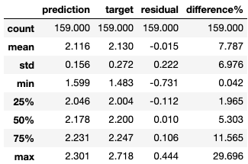
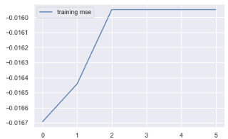
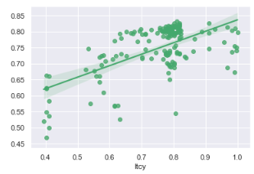
Linear Regression
Sklearn grid search, cv=10 folds
5 Features selected
[svc_cpu_sat, system_cpu_use,
System_cpu_sat, svc_req_rate ]
Evaluation
R-squared = 0.382
MSE = 0.105

Slide 14
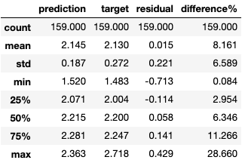
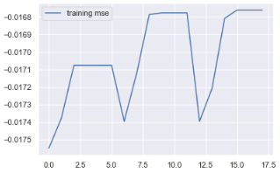
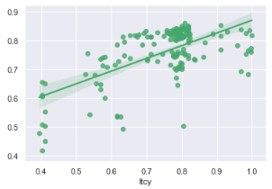
SVR
Sklearn grid search, cv=10 folds
5 Features selected [svc_cpu_sat, system_cpu_use,
System_cpu_sat, svc_req_rate ]
Evaluation
R-squared = 0.388
MSE = 0.105
Very much same as LR

Slide 15
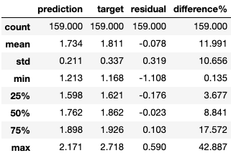
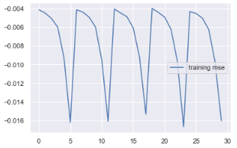
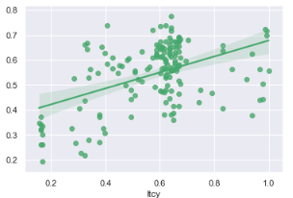
RandomForestRegressor
Sklearn grid search, cv=10 folds
Evaluation
R-squared = 0.178
MSE = 0.17
Worst than SVR and LR

Slide 16
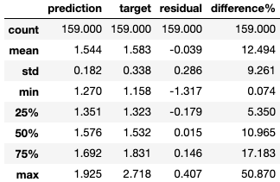
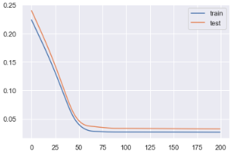
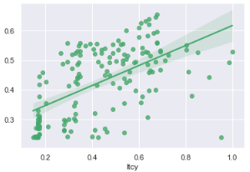
MLP
Tried many arichitectures
11 inputs -> 8 -> 4 -> 2
Epochs=200, batch_size=300, lr=1e-3
Feature selected first
Evaluation
R-squared = 0.335
MSE = 0.167
A little behind LR. Needs more samples

Slide 17
Results
Model | R-squared | MSE
SVR | 0.383 | 0.105
LR | 0.382 | 0.105
MLP | 0.345 | 0.167
RFR | 0.178 | 0.167

Slide 18
Efforts and Triage
Experimented by deploying app to 2 different cloud platforms, google and Linode (cheaper)
experimented by collecting both pre-calculated metrics via Prometheus rules and raw metrics
Easier to obtain the 95-percentile of latency with pre-calc rules, but consume time during metric scrape
Raw data takes a long time to pull from the stored TS-DB (used Postgresql)
Experiment needs to apply loads with different number of users (used Locust)
Experimented with predicting instant latency, and in progress to evaluate predicting a forecasted latency using past observations (I see it more useful in practice)
Two branches in github, google for current prediction, linode for future forecast

Slide 19
Plan
Add more samples
Try different MLP architectures
Evaluate future forecast of latency using historical time-widow of observations (time-series data)
Consider evaluate current and future forecast for only one service in the flow (like the “cart” service)
Propose a practical useful methodology for AIOPs to apply prediction flow using available tools.
Update current manuscript to summarize and report the findings.

Slide 20
Thanks

